Slide 1
<number>
Innovation Laboratory
Yield prediction for Carmen Rosa farm
Diego Alarcón
diego_alonso.alarcon_diaz@stud-mail.uni-wuerzburg.de

Slide 2
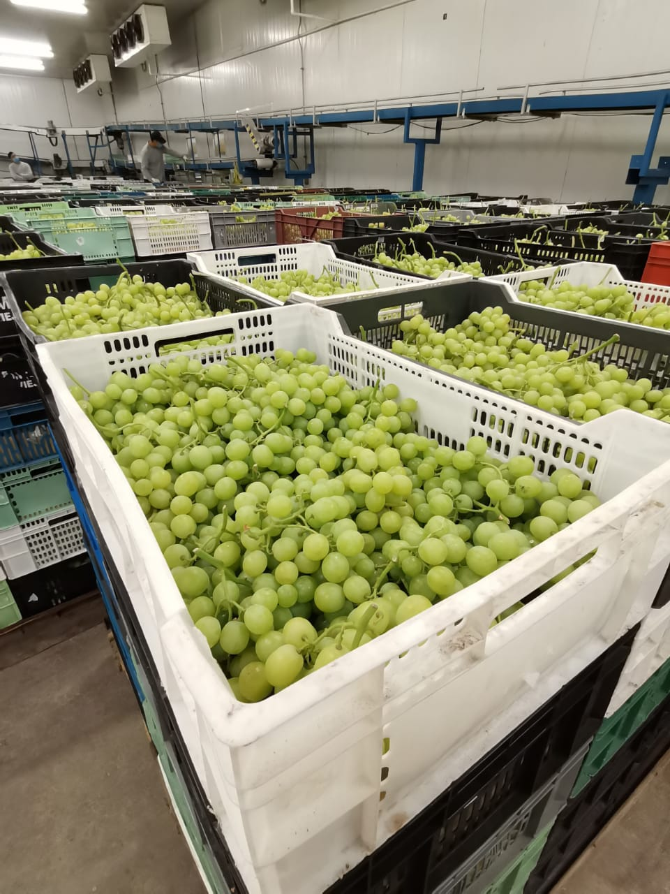
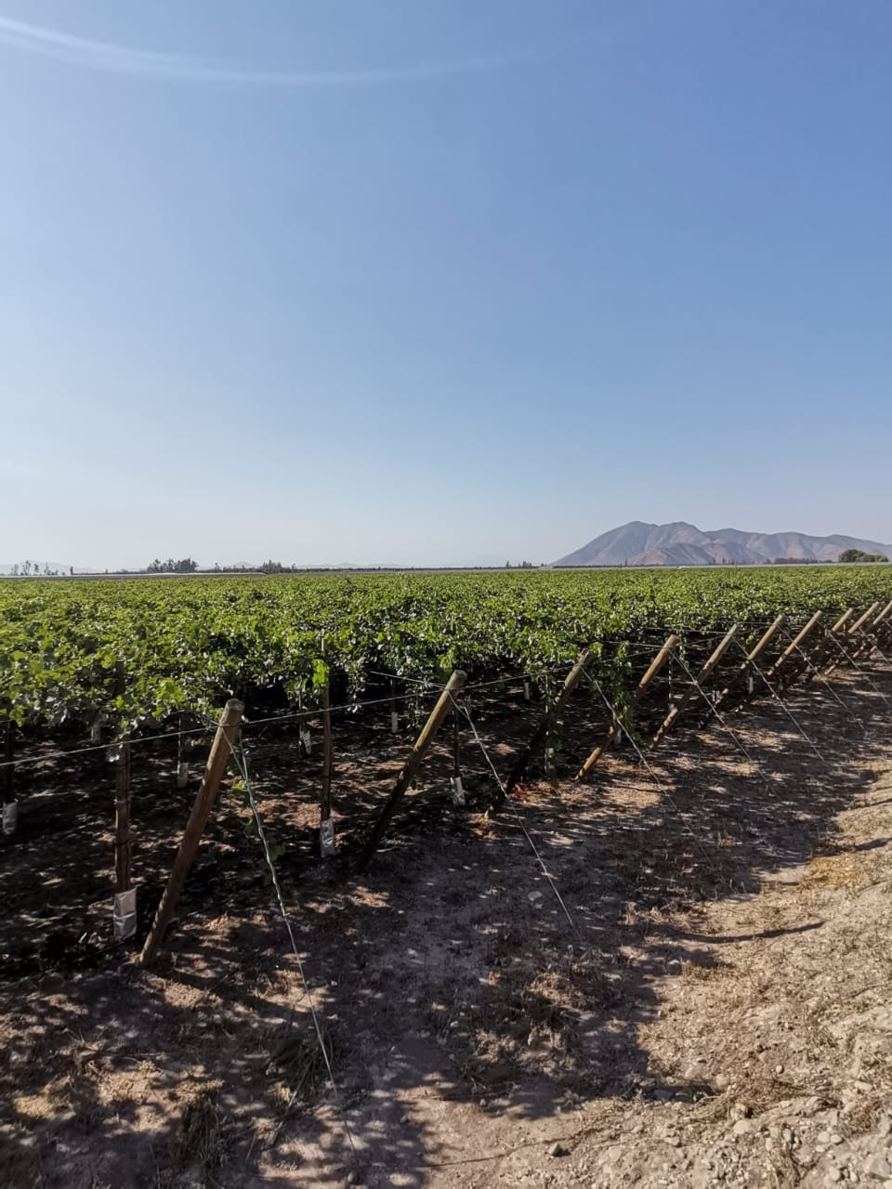
Motivation
<number>
Source: Carmen Rosa company
Source: Carmen Rosa company

Slide 3
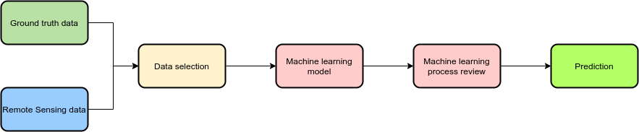





Workflow
<number>

Slide 4
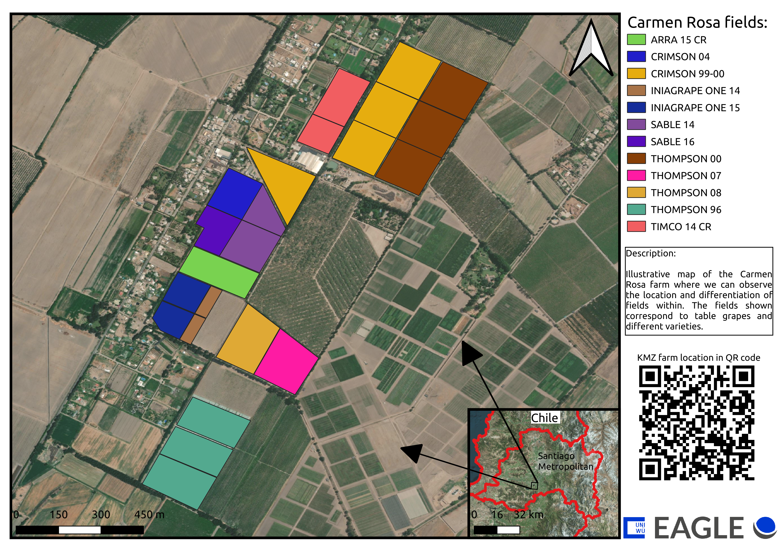
Area of study
<number>
Figure 1: Map Carmen Rosa farm.

Slide 5
Ground truth data - Production
<number>
 |  | Year | 13-14 | 14-15 | 15-16 | 16-17 | 17-18 | 18-19 | 19-20
Variety | Field | Surface (He) | Total Kg produced by He | Total Kg produced by He | Total Kg produced by He | Total Kg produced by He | Total Kg produced by He | Total Kg produced by He | Total Kg produced by He
THOMPSON | THOMPSON 00 | 9.60 | 38,225 | 50,364 | 36,898 | 37,556 | 42,209 | 31,974 | 37,808
THOMPSON | THOMPSON 07 | 3.40 | 21,401 | 58,425 | 41,733 | 35,366 | 37,818 | 27,008 | 38,151
THOMPSON | THOMPSON 08 | 3.40 | 12,361 | 50,571 | 43,396 | 41,152 | 47,094 | 30,372 | 34,098
THOMPSON | THOMPSON 96 | 9.50 | 15,321 | 52,965 | 35,357 | 32,043 | 39,654 | 27,944 | 36,523
CRIMSON | CRIMSON 99-00 | 12.20 | 61,652 | 48,716 | 40,552 | 58,012 | 48,920 | 53,385 | 52,420
CRIMSON | CRIMSON 04 | 2.40 | 64,986 | 58,127 | 45,277 | 57,662 | 45,585 | 61,284 | 52,501
ARRA | ARRA 15 CR | 2.90 |  |  |  | 22,311 | 45,286 | 53,119 | 44,983
TIMCO | TIMCO 14 CR | 4.10 |  |  |  | 13,510 | 48,340 | 50,073 | 74,931
INIAGRAPEONE | INIAGRAPE ONE 14 | 1.1 |  |  | 6,968 | 31,768 | 56,279 | 46,748 | 24,633
INIAGRAPEONE | INIAGRAPE ONE 15 | 3.0 |  |  |  |  |  | 47,891 | 26,805
SABLE | SABLE 14 | 4.2 |  |  | 8,551 | 21,504 | 36,082 | 34,794 | 50,315
SABLE | SABLE 16 | 1.9 |  |  |  |  |  | 8,711 | 40,520
Table 1: Data provided by Carmen Rosa Farm

Slide 6
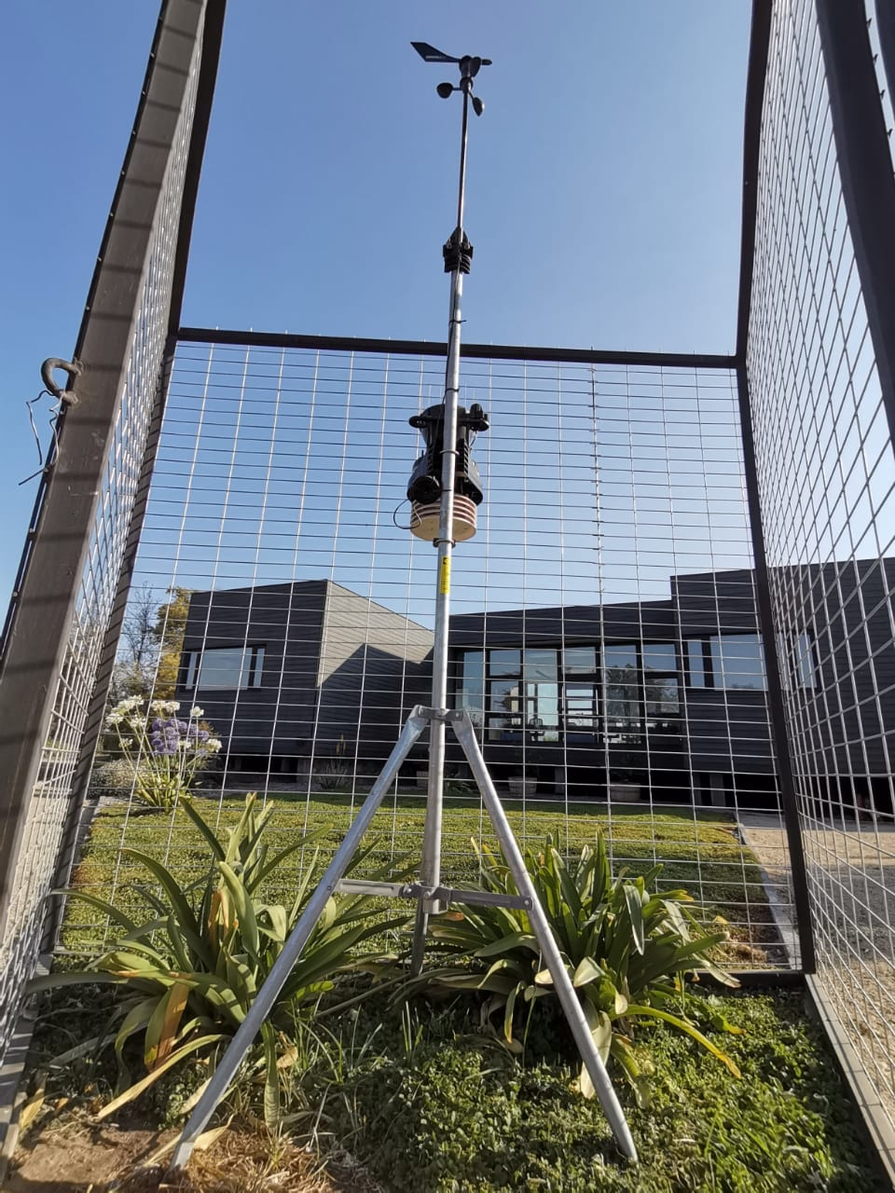
Ground truth data - Weather station
<number>
Temperature
Evapotranspiration
Humidity
Fields area
Grade day
Annual production
Source: Carmen Rosa company

Slide 7
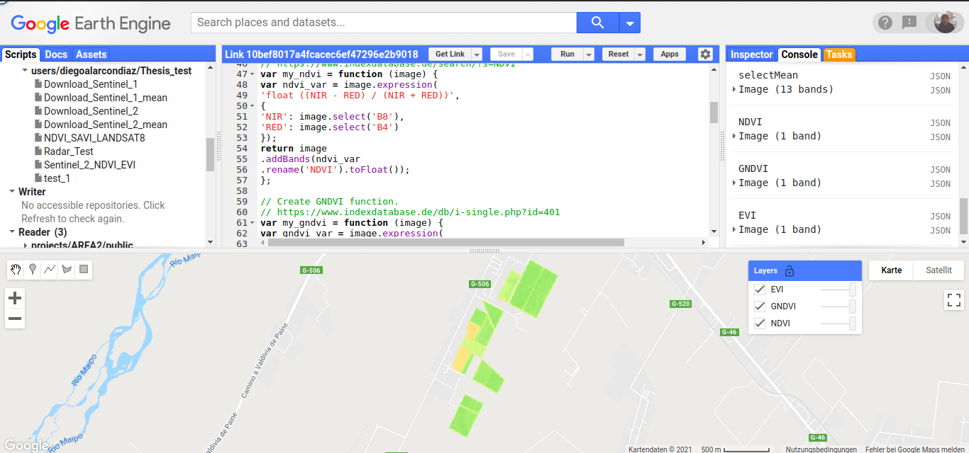
Remote Sensing data - GEE
<number>
Figure 1: Bloom's Cognitive Domain (Benitez 2012)
Source: Google.com

Slide 8
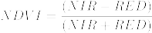
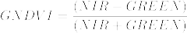
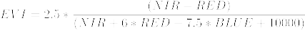
Remote Sensing data - Index
<number>

Slide 9
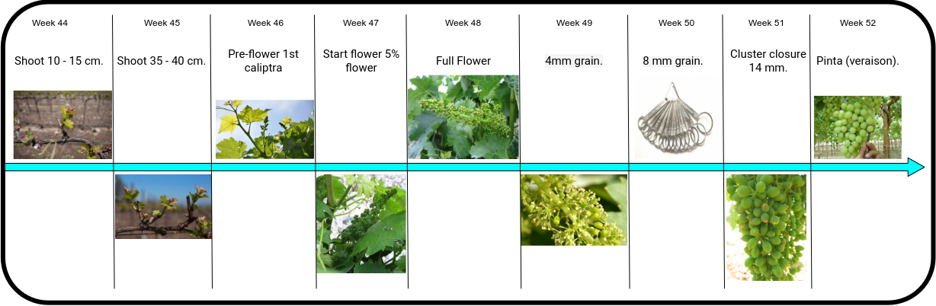
Phenological state
<number>

Slide 10
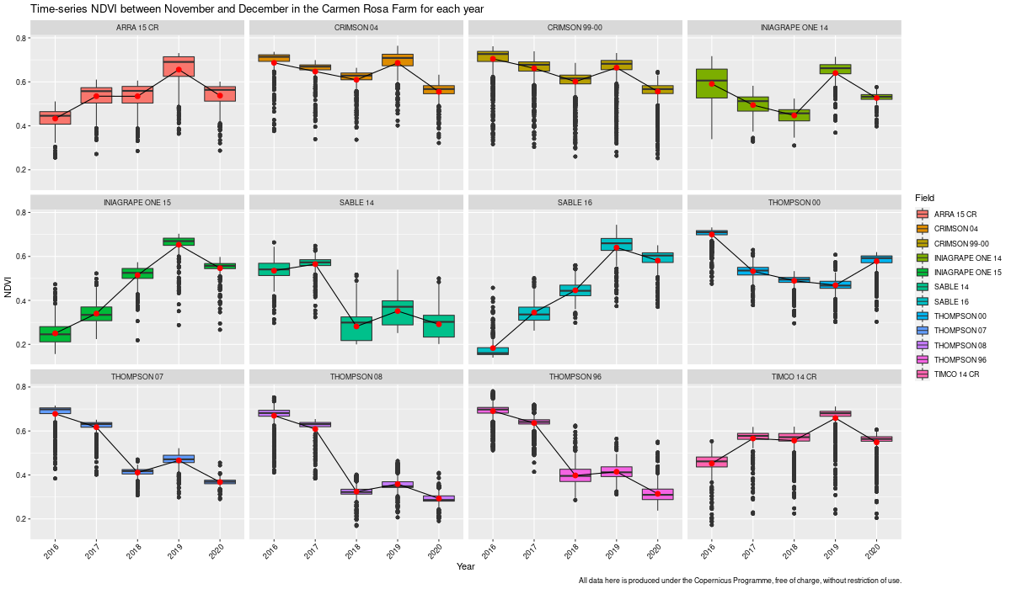
Analysis NDVI
<number>
Figure 2: NDVI analysis phenologycal stage between years 2016 -2020
*For the fields 'INIAGRAPE ONE 15' and 'SABLE 16', only the years 2018 to 2020 are valid.
*The other data was removed from the data frame to create the machine learning model.

Slide 11
Analysis Machine Learning – Model parameter
<number>

Slide 12
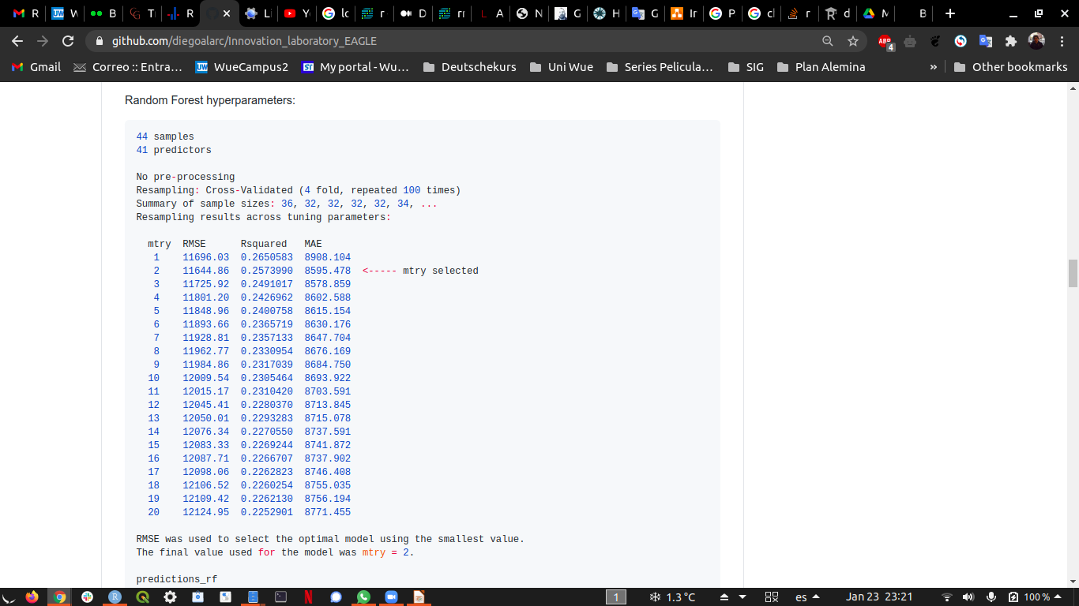
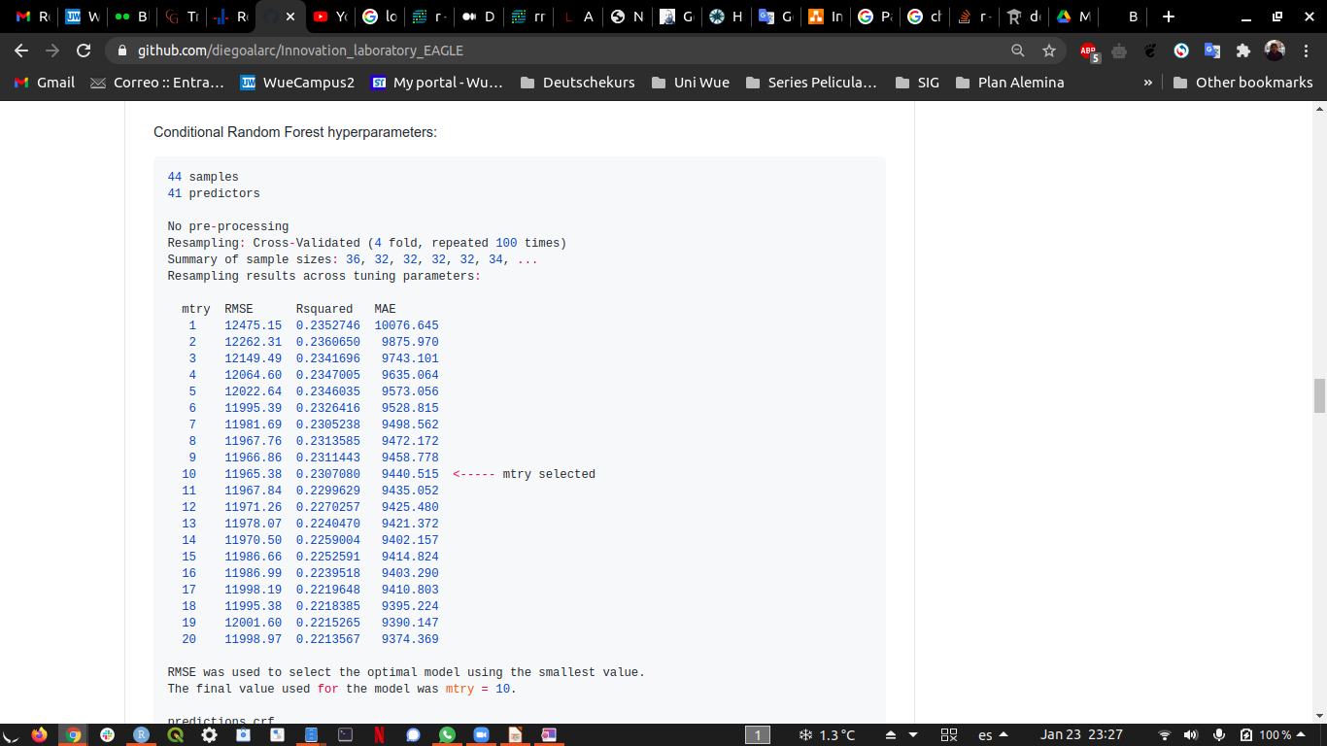
Analysis Machine Learning - Model
<number>
Random Forest
Conditional Random Forest
Figure 3: Information machine learning model generated

Slide 13
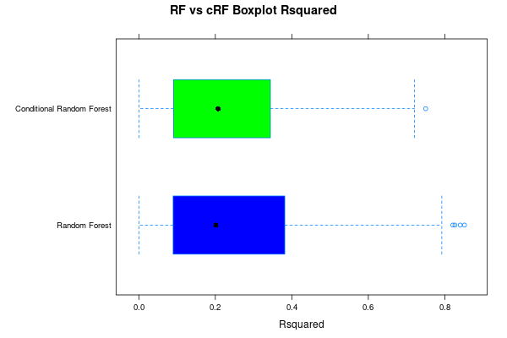
Analysis Machine Learning - Model
<number>
Figure 4: Rsquared comparison between RF and cRF models produced

Slide 14
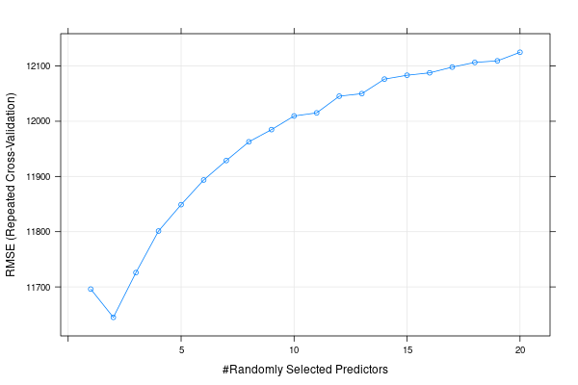
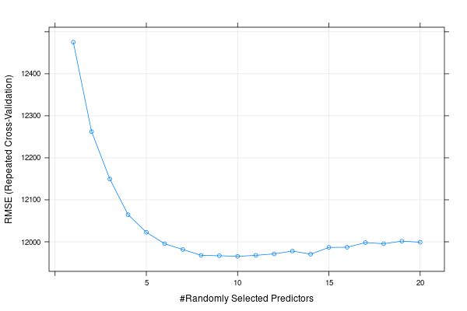
Analysis Machine Learning - Model
<number>
Random Forest
Conditional Random Forest
Figure 5: RMSE comparison between RF and cRF mtry cross validation

Slide 15
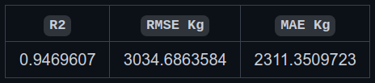
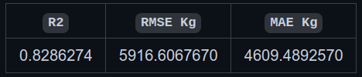
Analysis Machine Learning - Model evaluation
<number>
Random Forest
Conditional Random Forest
Figure 6: Comparison between RF and cRF using validation data

Slide 16
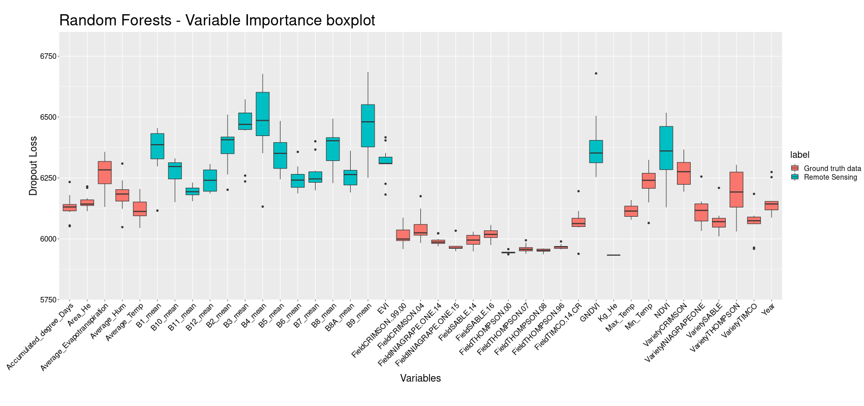
Analysis Machine Learning - Variable
<number>
Figure 7: Variable importance Random Forest

Slide 17
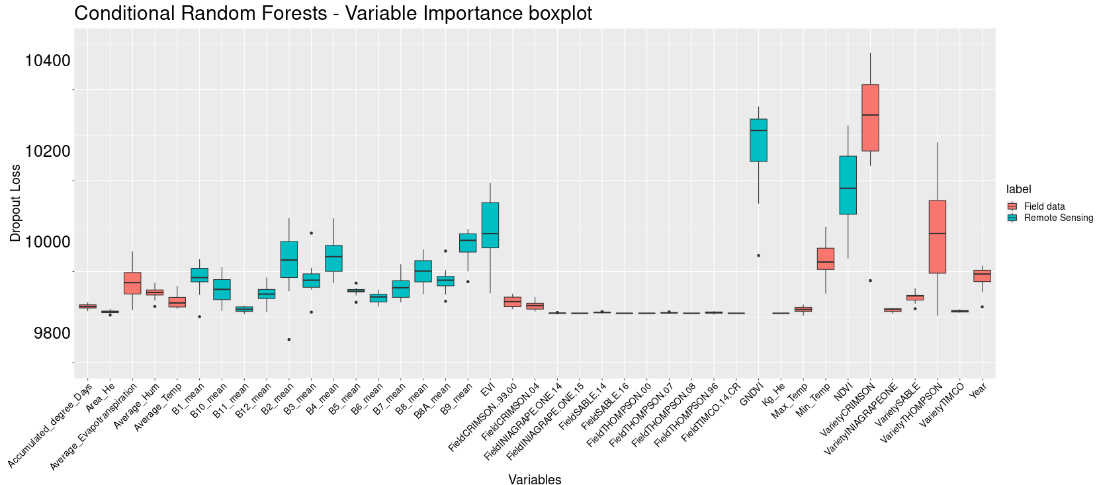
Analysis Machine Learning - Variable
<number>
Figure 8: Variable importance conditional Random Forest

Slide 18
Results
<number>
Random Forest
Variety | Field | Year | Area_He | Kg_He
THOMPSON | THOMPSON 00 | 2021 | 9.6 | 41357.7977096304
THOMPSON | THOMPSON 07 | 2021 | 3.4 | 36689.4504366268
THOMPSON | THOMPSON 08 | 2021 | 3.4 | 35831.9454180071
THOMPSON | THOMPSON 96 | 2021 | 9.5 | 35798.0735234639
CRIMSON | CRIMSON 99-00 | 2021 | 12.2 | 45890.9988594843
CRIMSON | CRIMSON 04 | 2021 | 2.4 | 47082.2595503199
ARRA | ARRA 15 CR | 2021 | 2.9 | 44344.6312243955
TIMCO | TIMCO 14 CR | 2021 | 4.1 | 43648.8121403448
INIAGRAPEONE | INIAGRAPE ONE 14 | 2021 | 1.1 | 42528.3456174134
INIAGRAPEONE | INIAGRAPE ONE 15 | 2021 | 3 | 42693.726853647
SABLE | SABLE 14 | 2021 | 4.2 | 36598.9735786702
SABLE | SABLE 16 | 2021 | 1.9 | 40690.0046396989
Table 2: Data predicted by the Random Forest model

Slide 19
Results
<number>
Conditional Random Forest
Variety | Field | Year | Area_He | Kg_He
THOMPSON | THOMPSON 00 | 2021 | 9.6 | 40630.3478980829
THOMPSON | THOMPSON 07 | 2021 | 3.4 | 35272.6115914895
THOMPSON | THOMPSON 08 | 2021 | 3.4 | 35009.3554826691
THOMPSON | THOMPSON 96 | 2021 | 9.5 | 34895.3375997666
CRIMSON | CRIMSON 99-00 | 2021 | 12.2 | 44551.796429587
CRIMSON | CRIMSON 04 | 2021 | 2.4 | 45011.1310551689
ARRA | ARRA 15 CR | 2021 | 2.9 | 42912.3193929731
TIMCO | TIMCO 14 CR | 2021 | 4.1 | 42191.3154600087
INIAGRAPEONE | INIAGRAPE ONE 14 | 2021 | 1.1 | 41554.7408015287
INIAGRAPEONE | INIAGRAPE ONE 15 | 2021 | 3 | 41840.732953901
SABLE | SABLE 14 | 2021 | 4.2 | 35848.9520325514
SABLE | SABLE 16 | 2021 | 1.9 | 43400.768352273
Table 3: Data predicted by the conditional Random Forest model

Slide 20
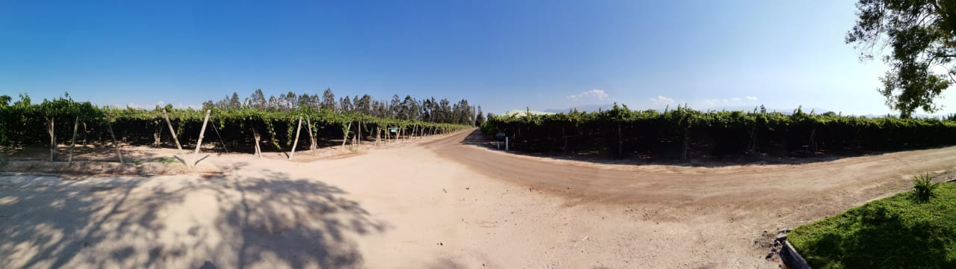
Results
<number>
Use of Machine Learning
Variables interpretation (RS & Field data)
Yield forecasting
Source: Carmen Rosa company

Slide 21
Conclusions and possible improvements
<number>
Random Forest best performance.
Yield forecasting in the next months of February and March.
Remote Sensing data is the important for the model.
Possible improvement with SAR data (Time-Series).
Test if possible regardless of the size of the observations.

Slide 22
Bibliography
<number>
Gitelson, A.A.; Kaufman, Y.J.; Merzlyak, M.N. Use of a green channel in remote sensing of global vegetation from EOS-MODIS. Remote Sens. Environ. 1996, 58, 289–298.
Xia, Rong, "Comparison of Random Forests and Cforest: Variable Importance Measures and Prediction Accuracies" (2009). All Graduate Plan B and other Reports. 1255. https://digitalcommons.usu.edu/gradreports/1255
Crane-Droesch, Andrew. (2018). Machine learning methods for crop yield prediction and climate change impact assessment in agriculture. Environmental Research Letters. 13. 10.1088/1748-9326/aae159.
Braga, Dieinison & Coelho da Silva, Ticiana & Rocha, Atslands & Coutinho do Rêgo, Luís Gustavo & Pires Magalhaes, Regis & Guerra, Paulo. (2020). Time Series Forecasting to Support Irrigation Management. Journal on Data Semantics. 10. 66-80.
Zhao, Yan & Potgieter, Andries & Zhang, Miao & Wu, Bingfang & Hammer, G.. (2020). remote sensing Predicting Wheat Yield at the Field Scale by Combining High-Resolution Sentinel-2 Satellite Imagery and Crop Modelling. Remote Sensing. 12. 10.3390/rs12061024.
Pantazi, X.E. & Moshou, Dimitrios & Alexandridis, Thomas & Whetton, Rebecca & Mouazen, Abdul. (2016). Wheat yield prediction using machine learning and advanced sensing techniques. Computers and Electronics in Agriculture. 121. 57-65. 10.1016/j.compag.2015.11.018.
Al-Gaadi, K.A. & Hassaballa, Abdalhaleem A. & Tola, Elkamil & Kayad, Ahmed & Madugundu, Rangaswamy & Alblewi, Bander & Assiri, Fahad. (2016). Prediction of Potato Crop Yield Using Precision Agriculture Techniques. PloS one. 11. e0162219. 10.1371/journal.pone.0162219.
Breiman L (2001). Random Forests. Machine Learning, 45(1), 5–32.
Hothorn T, Hornik K, Zeileis A (2006b). Unbiased Recursive Partitioning: A Conditional Inference Framework. Journal of Computational and Graphical Statistics, 15(3), 651–674.
Kuhn, M. (2008). Building Predictive Models in R Using the caret Package. Journal of Statistical Software, 28(5), 1 - 26. doi:http://dx.doi.org/10.18637/jss.v028.i05
Wickham H (2016). ggplot2: Elegant Graphics for Data Analysis. Springer-Verlag New York. ISBN 978-3-319-24277-4, https://ggplot2.tidyverse.org.
Wickham et al., (2019). Welcome to the tidyverse. Journal of Open Source Software, 4(43), 1686, https://doi.org/10.21105/joss.01686

Slide 23
<number>
Thanks for your attention!!!
https://github.com/diegoalarc/Innovation_laboratory_EAGLE
Questions?

